Slide 1

For Live Session
TS Unit 2
Nicholas Sager

Slide 2
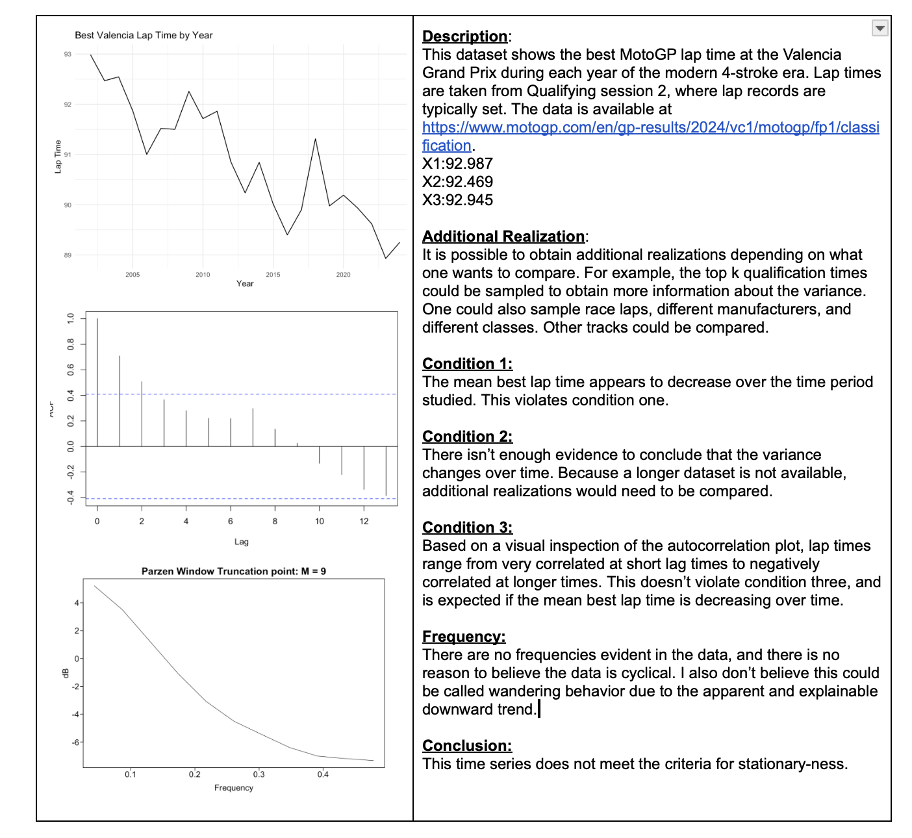
Sample Time Series

Slide 3
Takeaways
Periodic Functions: f(x) is periodic if exists a p where p is the smallest value s.t. f(x) = f(x + kp) for all integers k.
Ex: 2*pi for sin and cos
Pseudo-periodic: p is the smallest value where the cycle appears to repeat.
Frequency: Number of cycles per unit (1/p).
Fundamental Goal: Discover frequencies when present.
Fourier Expansion: Non-cyclic functions expressed as a linear combination of sines and cosines.
Spectral Density: Visual representation of frequencies present
See notes for estimation formulas. (tswge uses parzen window).
Often plotted as logarithm to highlight secondary peaks.

